Slide 1
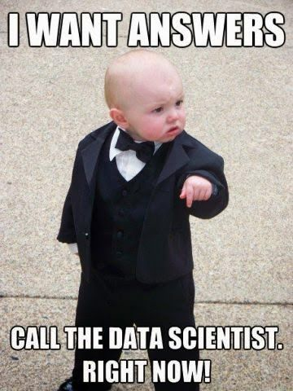
Data Science
General Assembly Lecture – Introduction
Instructor: Hamed Hasheminia

Slide 2
Instructor: Hamed Hasheminia
TAs
TA1
TA2
Office Hours: TBA
Course Producer: Vanessa Ohta
Course Times: Mondays and Wednesday (6:30PM to 9:30PM)
(Jan 27th 2016 to Apr 6th 2016) – No class on Monday, Feb 15th
Location: 225 Bush St, 5th Floor

Slide 3
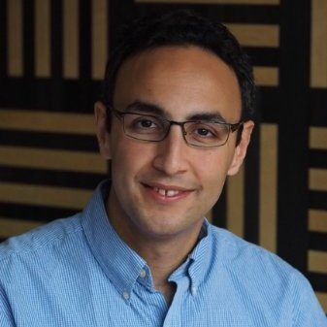







A little about me
Projects with substantial data science components that I have been involved with:
Insurance Corporation of British Columbia
WestJet
Transport of Canada
Logico Carbon Solutions
Prince Rupert Authorities

Slide 4
A little bit about yourself
Your Name
Summary of your background
What are you hoping/expecting to get out of this class
Some interesting factoid about yourself

Slide 5
Course Overview
Instructor Philosophy
Content Philosophy
How to succeed
Typical Class

Slide 6
Instructor Philosophy
Adjustable pace
Interactive Class
Learn how to learn
Learn by teaching
Slow and constant progress

Slide 7
Content Philosophy
Learn by doing
In-Class examples
Assignments
Course Project
Practice, Practice, Practice
Extensive use of visuals
Balance of depth with breadth

Slide 8
How to succeed
You cannot drive by just sitting on the passenger seat
Ask questions
Answer questions
Teach to your classmates
You only learn something when you can teach it to somebody else.
Practice, Practice, Practice

Slide 9
Typical Class
Review of previous materials
Theoretical lecture – from PowerPoint slides
Lab / Code Walk-through
In-class exercises
Homework assigned

Slide 10
GA GRADUATION REQUIREMENTS
Homework (80% of Homework and Labs)
Attendance (Miss no more than 2 classes)
Final Project

Slide 11
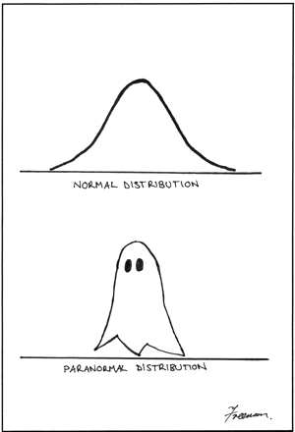
Data Science
General Assembly Lecture – 1
What is Data Science?
Instructor: Hamed Hasheminia

Slide 12
Agenda
What is Data Science?
What Roles do Exist in Data Science?
What tools and approaches do Data scientists use to analyze Data?
LAB:
Working at the UNIX command line
Set up github
Intro Python

Slide 13
What is Data Science?
The analysis of data using the scientific method. (It may be the most overused term of the year, but you're unlikely to have a meeting where the topic does not come up.) [Shelly Palmer]
An interdisciplinary, problem-solving oriented subject
The application of scientific techniques to practical problems

Slide 14
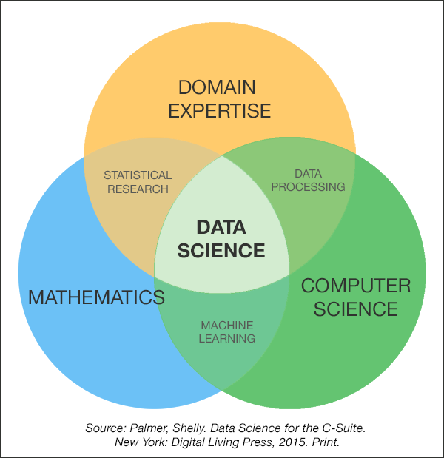
What is Data Science?

Slide 15
What is a Data Scientist
“‘Data Scientist’ is a Data Analyst who lives in California”
"A data scientist is someone who is better at statistics than any software engineer and better at software engineering than any statistician."
“A data scientist is a business analyst who lives in New York.”
"A data scientist is a statistician who lives in San Francisco."
"Data Science is statistics on a Mac."

Slide 16
Data Scientist
“A data scientist is that unique blend of skills that can both unlock the insights of data and tell a fantastic story via the data,” – [DJ Patil]
An ideal data scientist is “someone who has the both the engineering skills to acquire and manage large data sets, and also has the statistician’s skills to extract value from the large data sets and present that data to a large audience.” – [John Rauser]

Slide 17
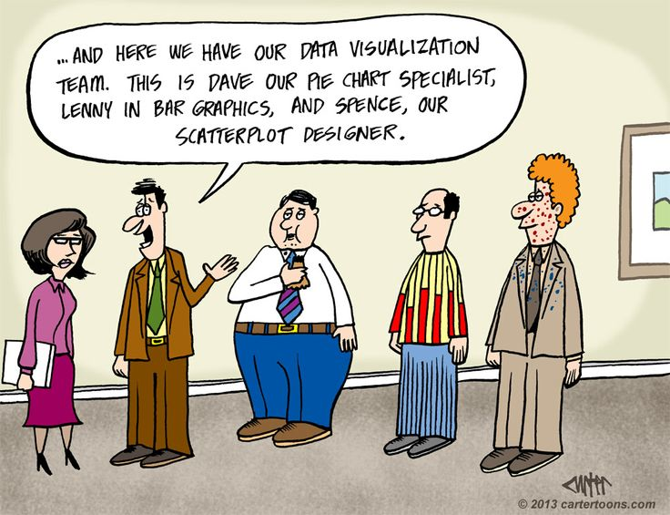
Who is a Data Scientist?

Slide 18
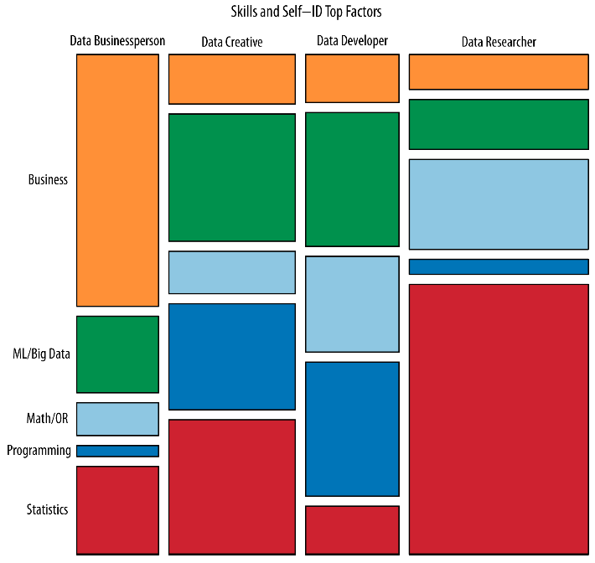
http://cdn.oreillystatic.com/oreilly/radarreport/0636920029014/Analyzing_the_Analyzers.pdf

Slide 19
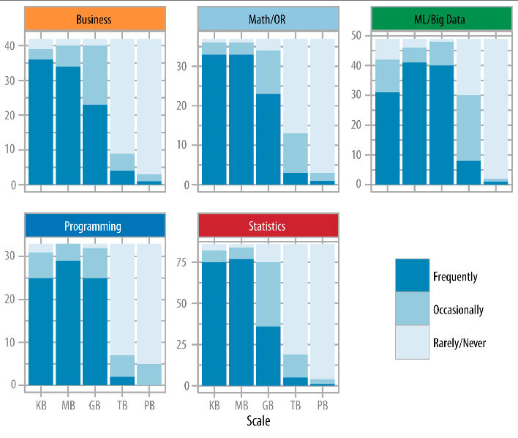
http://cdn.oreillystatic.com/oreilly/radarreport/0636920029014/Analyzing_the_Analyzers.pdf

Slide 20
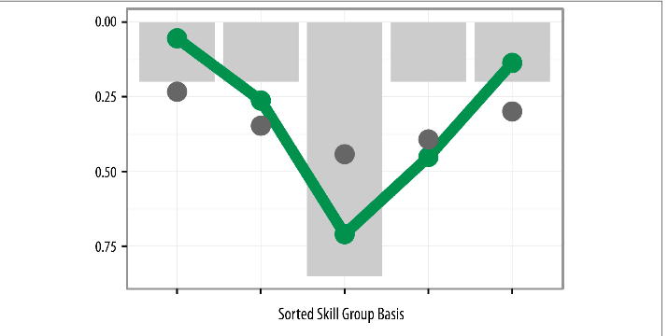
T-Shaped Data Scientists
http://cdn.oreillystatic.com/oreilly/radarreport/0636920029014/Analyzing_the_Analyzers.pdf

Slide 21
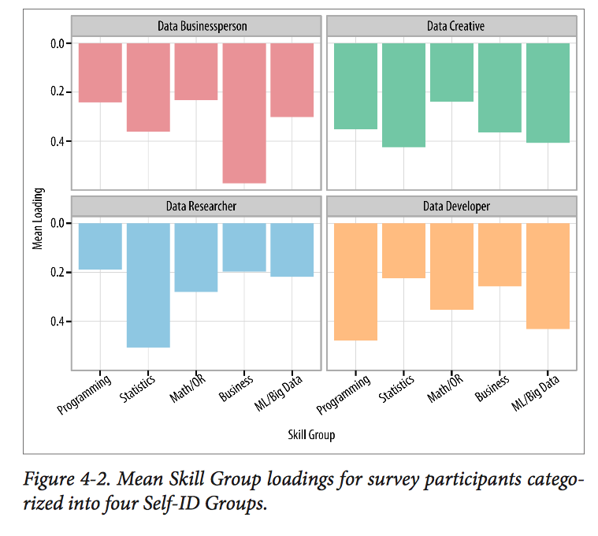
T-Shaped Data Scientists
http://cdn.oreillystatic.com/oreilly/radarreport/0636920029014/Analyzing_the_Analyzers.pdf

Slide 22
OVERVIEW OF THE DATA SCIENCE WORKFLOW
A methodology for doing Data Science
Similar to the scientific method
Helps produce reliable and reproducible results
Reliable: Accurate findings
Reproducible: Others can follow your steps and get the same results

Slide 23
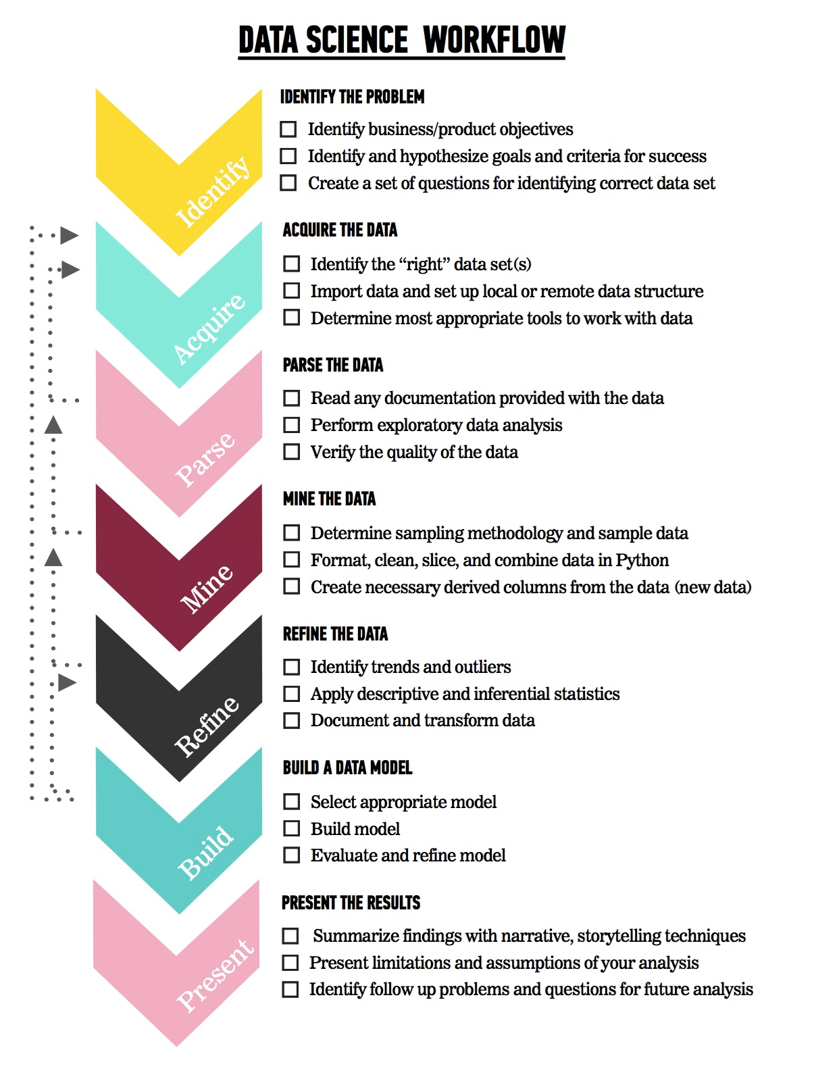
OVERVIEW OF THE DATA SCIENCE WORKFLOW
The steps:
Identify the problem
Acquire the data
Parse the data
Mine the data
Refine the data
Build a data model
Present the results

Slide 24
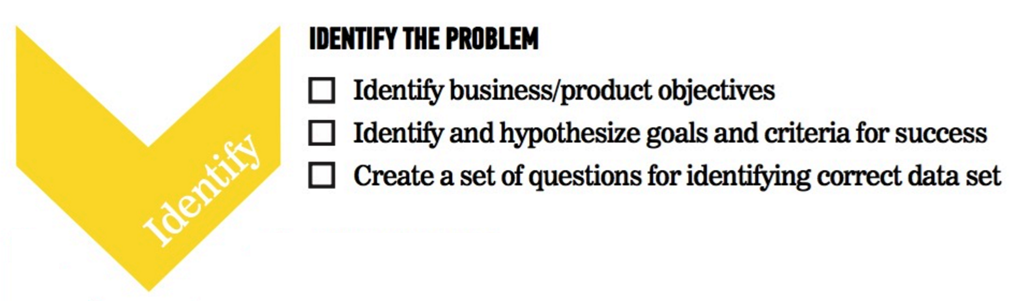
OVERVIEW OF THE DATA SCIENCE WORKFLOW

Slide 25
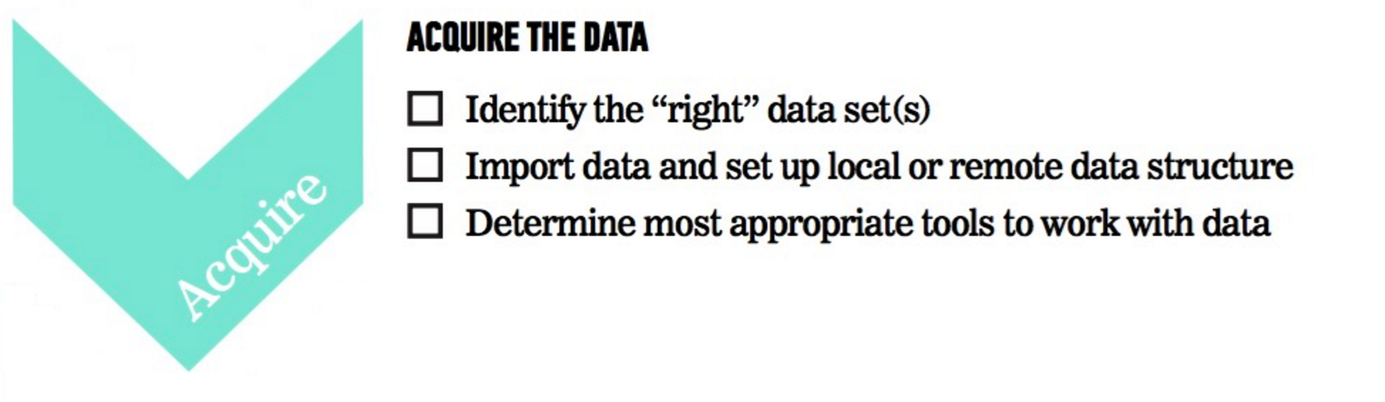
OVERVIEW OF THE DATA SCIENCE WORKFLOW

Slide 26
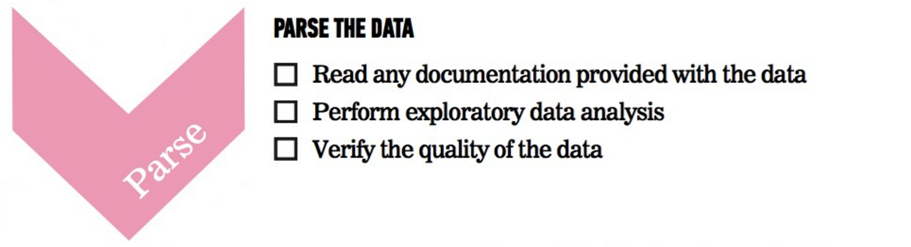
OVERVIEW OF THE DATA SCIENCE WORKFLOW

Slide 27
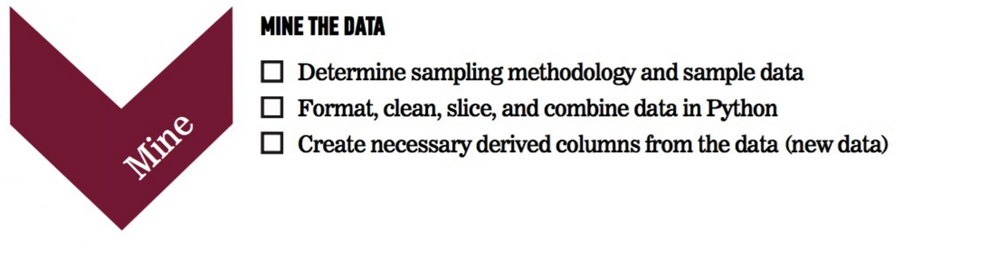
OVERVIEW OF THE DATA SCIENCE WORKFLOW

Slide 28
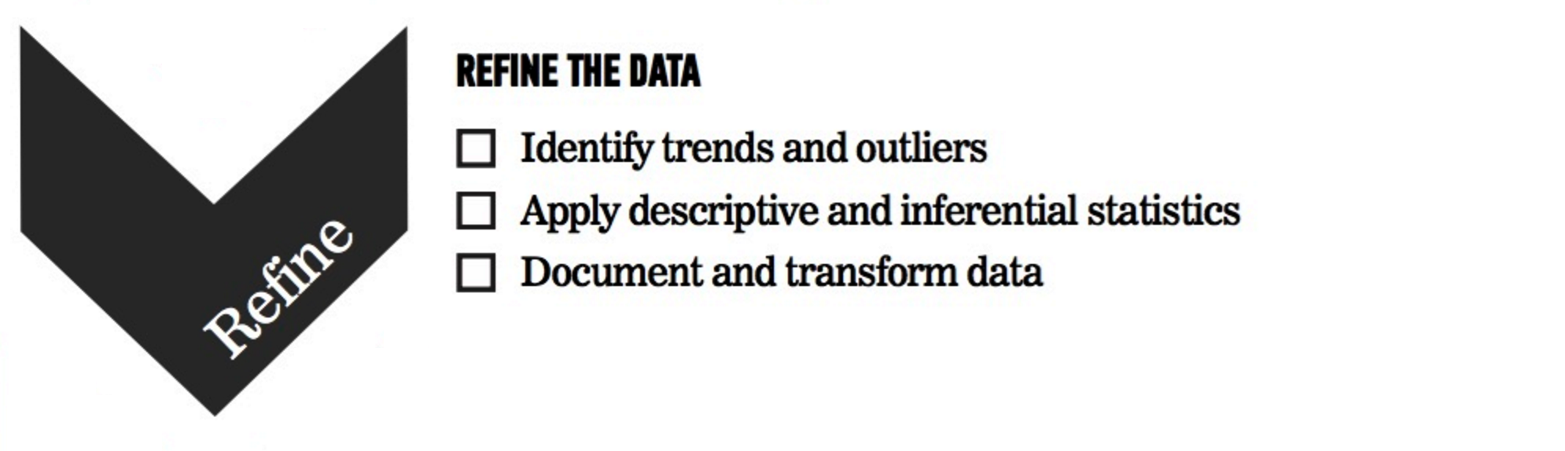
OVERVIEW OF THE DATA SCIENCE WORKFLOW

Slide 29

OVERVIEW OF THE DATA SCIENCE WORKFLOW

Slide 30
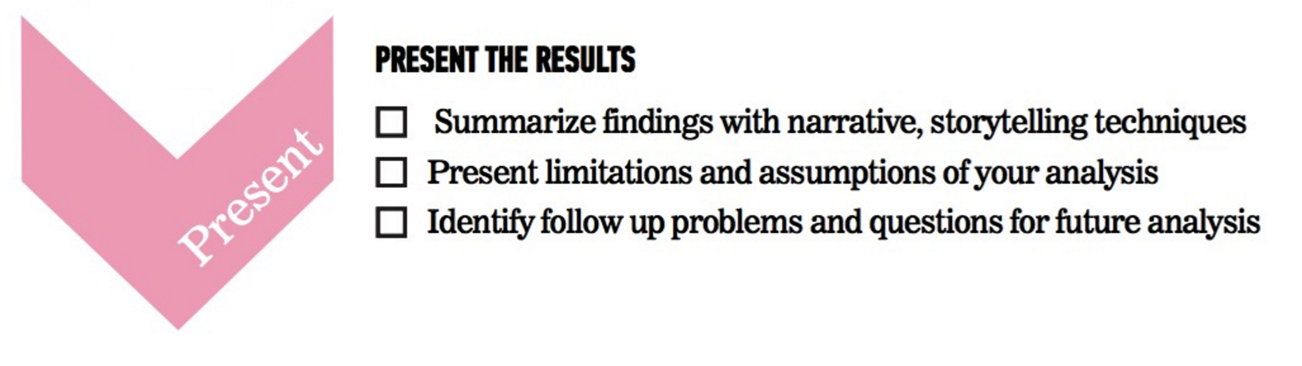
OVERVIEW OF THE DATA SCIENCE WORKFLOW

Slide 31
Data Science Workflow – Example
What are the leading indicators that a user will make a new purchase?
Collect Data around user retention, user actions within the product, potentially find data outside of company.
Extract aggregated values from raw data
How many times did a user share through Facebook within a week? A month?
How often did they open up our e-mails?
Examine data to find common distributions and correlations
Extract new meaning to predict if user would purchase again
Share results (and probably also go back to the drawing board)

Slide 32

ACTIVITY: DATA SCIENCE WORKFLOW
DIRECTIONS (25 minutes)
EXERCISE
Divide into 4 groups, each located at a whiteboard.
IDENTIFY: Each group should develop 1 research question they would like to know about their classmates. Create a hypothesis to your question. Don’t share your question yet! (5 minutes)
ACQUIRE: Rotate from group to group to collect data for your hypothesis. Have other students write or tally their answers on the whiteboard. (10 minutes)
PRESENT: Communicate the results of your analysis to the class. (10 minutes)
Create a narrative to summarize your findings.
Provide a basic visualization for easy comprehension.
Choose one student to present for the group.
DELIVERABLE
Presentation of the results

Slide 33
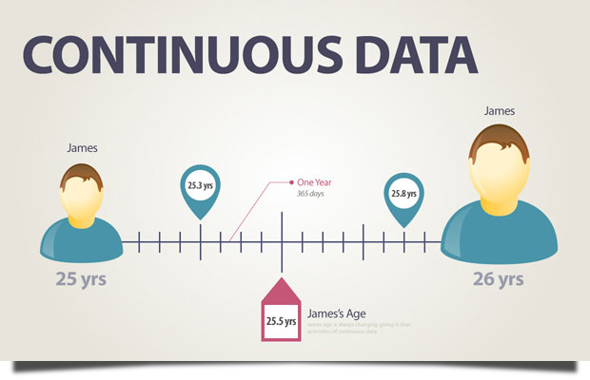
Continuous Data

Slide 34
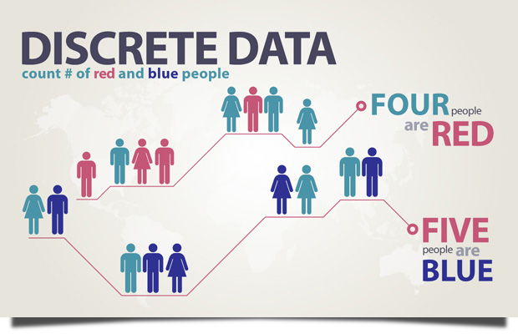
Discrete Data

Slide 35
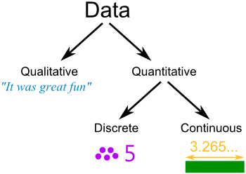
Discrete Data

Slide 36
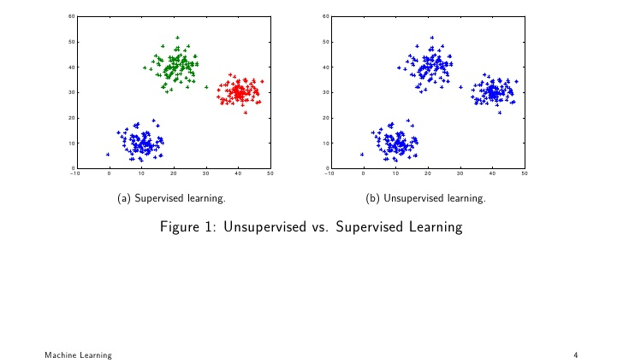
Supervised vs Unsupervised Learning

Slide 37
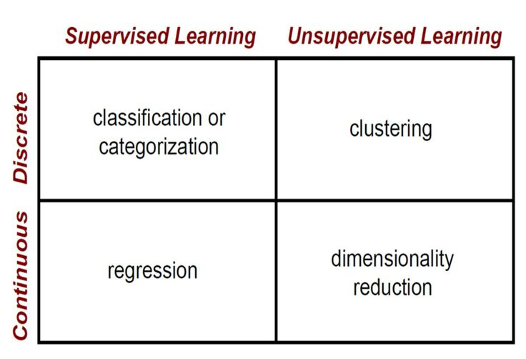
Supervised vs Unsupervised Learning

Slide 38
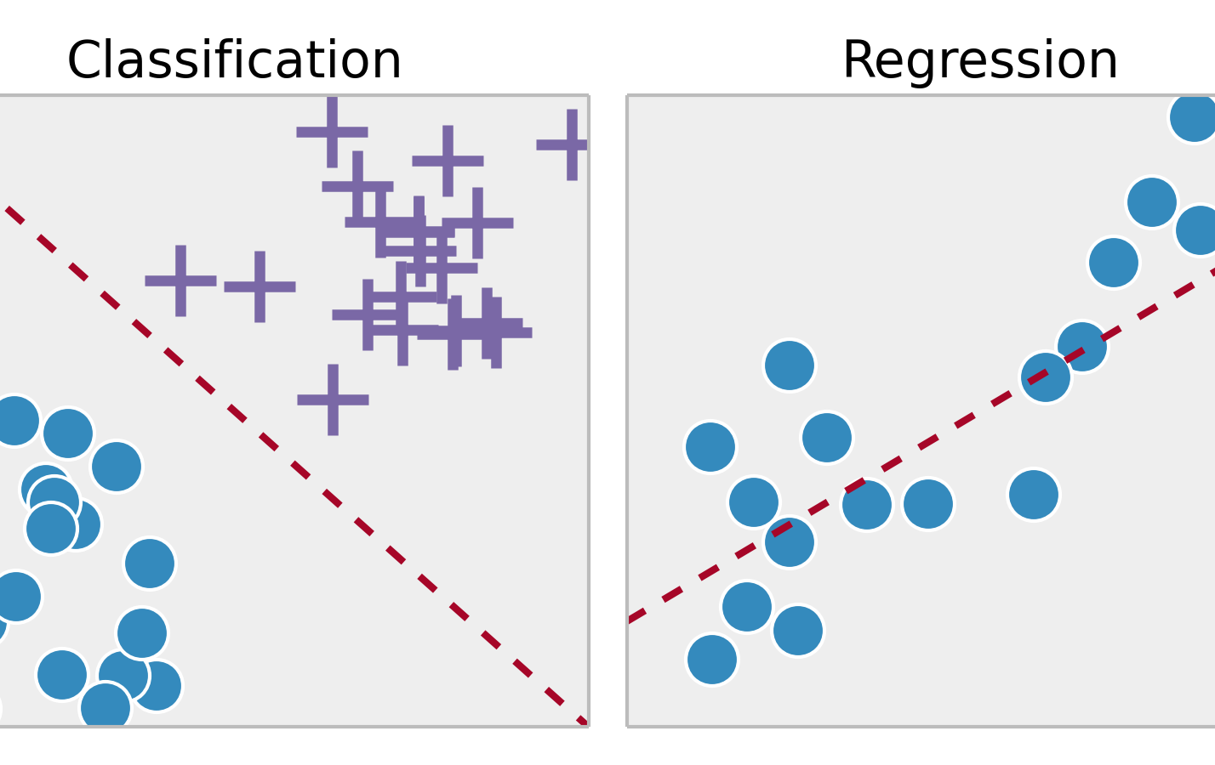
Supervised Learning – Classification vs Regression

Slide 39
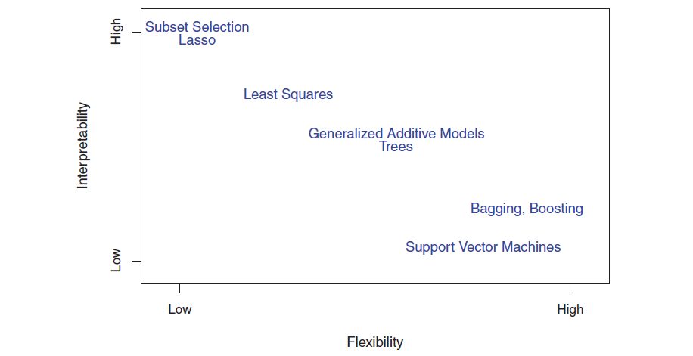
Flexibility vs Interpretability

Slide 40
Summary
Always ask your self what type of data you have. Continuous, Discrete or Qualitative
Do you have a response variable? If yes, you can use Supervised Learning techniques, otherwise you shall use Unsupervised Learning techniques
Ask whether you want to predict something or interpret it. Make sure you use models that are inline with your goal.

